Slide 1
OS Lab Assignment - 5

Slide 2
Group - 6
Abhijeet Sonkar (IIB2019009)
Avneesh Kumar (IIB2019010)
Ambika Singh (IIB2019017)
Aditya Aggarwal (IIT2019210)
Divy Agrawal (IIT2019211)

Slide 3

Question Statement
Implement the code of the page replacement algorithm LRU Approximation: Enhanced Second Chance Algorithm inside the getFrameNo() function and print the value of total page-fault-count from the Finalize() function.

Slide 4
Flow of Content
Basic Concepts
Code Explanation
Output Screenshots

Slide 5
1 Basic Concepts

Slide 6
Virtual Memory
An imaginary memory area supported by some operating systems in conjunction with the hardware
Programs use these virtual addresses rather than real addresses to store instructions and data. When the program is actually executed, the virtual addresses are converted into real memory addresses.
The purpose of virtual memory is to enlarge the address space, the set of addresses a program can utilize. For example, virtual memory might contain twice as many addresses as main memory

Slide 7
Page Replacement Algorithm
Page replacement algorithms decide which memory pages to page out, sometimes called swap out, or write to disk, when a page of memory needs to be allocated.
Page replacement happens when a requested page is not in memory (page fault) and a free page cannot be used to satisfy the allocation, either because there are none, or because the number of free pages is lower than some threshold.

Slide 8
Paging
Paging is a memory management scheme by which a computer stores and retrieves data from secondary storage for use in main memory. In this scheme, the operating system retrieves data from secondary storage in same-size blocks called pages.
Paging is an important part of virtual memory implementations in modern operating systems, using secondary storage to let programs exceed the size of available physical memory

Slide 9
Least Recently Used (LRU)
Least Recently Used page replacement algorithm keeps track of page usage over a short period of time. It works on the idea that the pages that have been most heavily used in the past are most likely to be used heavily in the future too.
In LRU, whenever page replacement happens, the page which has not been used for the longest amount of time is replaced.

Slide 10
Enhanced Second Chance Algo
The reference bit and modify bit form a pair (r,m) where -
(0,0) neither recently used nor modified - replace this page!
(0,1) not recently used but modified - not as good to replace, since the OS must write out this page, but it might not be needed anymore.
(1,0) recently used and unmodified - probably will be used again soon, but OS need not write it out before replacing it
(1,1) recently used and modified - probably will be used again soon and the OS must write it out before replacing.
On a page fault, the OS searches for the first page in the lowest nonempty class.
The OS goes around at most three times searching for the (0,0) class.
Page with (0,0) => replace the page.
Page with (0,1) => initiate an I/O to write out the page, locks the page in memory until the I/O completes, clears the modified bit, and continue the search.
For pages with the reference bit set, the reference bit is cleared.
If the hand goes completely around once, there was no (0,0) page. • On the second pass, a page that was originally (0,1) or (1,0) might have been changed to (0,0) => replace this page
If the page is being written out, waits for the I/O to complete and then remove the page.
A (0,1) page is treated as on the first pass.
By the third pass, all the pages will be at (0,0).

Slide 11
2 Code Explanation

Slide 12
void create_queue(){
queue=create_node();
struct node *start=queue;
for(int i=0;i<no_of_frames-1;i++){
start->next=create_node();
start=start->next;
}
start->next=queue;
}
This function is used to create the circular queue using linked list which is in turn used to implement page replacement algorithm.
struct node* create_node(){
struct node *new=NULL;
new=(struct node*)malloc(sizeof(struct node));
new->page_no=-1;
new->next=NULL;
return new;
}
This function is used to create a node for implementing a circular queue which is in turn used to implement page replacement algorithm.
int SwapOut(int fno,int old_pno){
if(PageTable[old_pno].modify_bit)
writeFrame(fno,old_pno);
PageTable[old_pno].modify_bit = 0;
PageTable[old_pno].reference_bit = 0;
return old_pno;
}
If the page which is to be replaced has a modify bit 1 then the page needs to be swapped out that means the data of the page has been modified and needs to be written back to file before bringing in a page which would be replacing it.

Slide 13
int getFrameNo(int pno){
int fno;
if(PageTable[pno].valid_bit){
PageTable[pno].reference_bit=1;
return PageTable[pno].frm_no;
}
In this if condition we will check whether the page which is required is already present in one of the frames or not. If it is present in one of the frame then we will return that frame number.
int i;
for(i=0;i<no_of_frames;i++){
if(FrameTable[i]==-1){
fno=i;
AddNewPage(queue,pno,fno);
queue=queue->next;
break;
}
}
If the page is not present in one of the frames then if there are some frames which are empty then we will bring the required page into this empty frame, valid bit corresponding to this page is set to 1 and return the number of this frame.

Slide 14
if(i==no_of_frames){
int victim_page=LRUEnchancedSecondChanceAlgorithm(pno);
fno=PageTable[victim_page].frm_no;
PageTable[victim_page].frm_no=-1;
}
printf("Alloted Frame Number=%d\n",fno);
readPage(pno, fno);
PageTable[pno].valid_bit=1;
return fno;
If no free frame is available then one of the pages stored in the frame needs to be replaced. The page(victim page) which needs to be replaced is determined by the function LRUEnchancedSecondChanceAlgorithm(pno). When the page which needs to be replaced is determined then the required page will be brought into the frame and the valid bit corresponding to it will be set to 1 and that of the victim page to 0 and its frame number to -1.

Slide 15
int LRUEnchancedSecondChanceAlgorithm(int pno){
int victim_page=check00(pno);
if(victim_page!=-1){
return SwapOut(PageTable[victim_page].frm_no,victim_page);
}
victim_page=check01(pno);
if(victim_page!=-1){
return SwapOut(PageTable[victim_page].frm_no,victim_page);
}
LRUEnchancedSecondChanceAlgorithm(pno);
}
This function is used to find the appropriate page which will be replaced by the incoming page in one of the frame. Here we will
find a page having reference bit and modify bit as 0 for replacement
If above page not found then find a page having reference bit 0 and modify bit 1 for replacement.
We will repeat the two steps until one of the two situation meets.
void AddNewPage(struct node *x,int new_page,int frame){
x->page_no=new_page;
PageTable[new_page].frm_no=frame;
PageTable[new_page].reference_bit=1;
PageTable[new_page].modify_bit=0;
}
This function will be used to bring the required page into the main memory by allotting one frame to it and storing the information in PageTable about the new page.

Slide 16
int check00(int new_page){
int reference=0,modify=0,page_no=-1;
if(PageTable[queue->page_no].reference_bit==reference &&
PageTable[queue->page_no].modify_bit==modify){
page_no=queue->page_no;
PageTable[page_no].valid_bit = 0;
AddNewPage(queue,new_page,PageTable[page_no].frm_no);
queue=queue->next;
return page_no;
}
pointer=queue->next;
int n=no_of_frames;
for(int i=0;i<n-1;i++){
int p=pointer->page_no;
if(PageTable[p].reference_bit==reference &&
PageTable[p].modify_bit==modify){
page_no=p;
PageTable[page_no].valid_bit = 0;
AddNewPage(pointer,new_page,PageTable[p].frm_no);
break;
}
pointer=pointer->next;
}
return page_no;
}
This function Is used to find a page in the circular queue having both reference bit and modify bit as 0. we will iterate until either we find the required page or reach the same position.

Slide 17
int check01(int new_page){
int reference=0,modify=1,page_no=-1;
int n=no_of_frames;
for(int i=0;i<n;i++){
int p=queue->page_no;
if(PageTable[p].reference_bit==reference && PageTable[p].modify_bit==modify){
page_no=p;
PageTable[page_no].valid_bit = 0;
AddNewPage(queue,new_page,PageTable[p].frm_no);
queue=queue->next;
break;
}
PageTable[p].reference_bit=0;
queue=queue->next;
}
return page_no;
}
This function will be called when no page is found to be replaced from frames having both modify bit and reference bit as 0. so now we will find a page having reference bit 0 and modify bit 1 in the circular queue. And while iterating if a corresponding page does not has reference bit 0 then we would set its reference bit to 0 and move further until we find the required page.

Slide 18
3 Output Screenshot

Slide 19
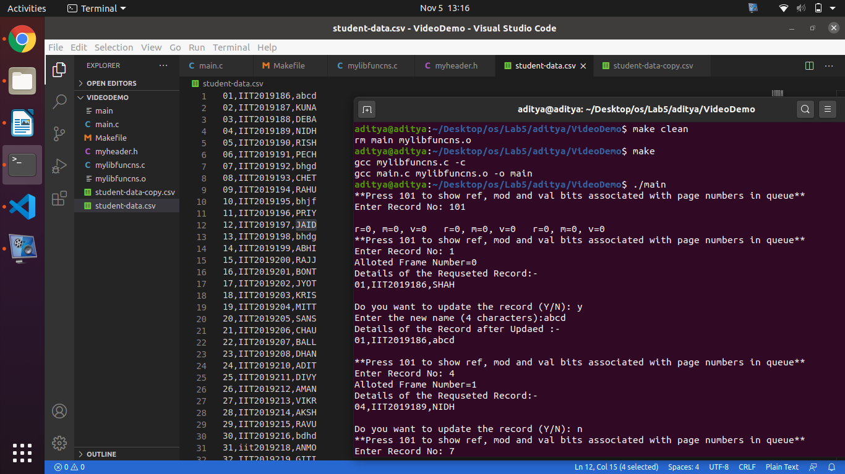

Slide 20
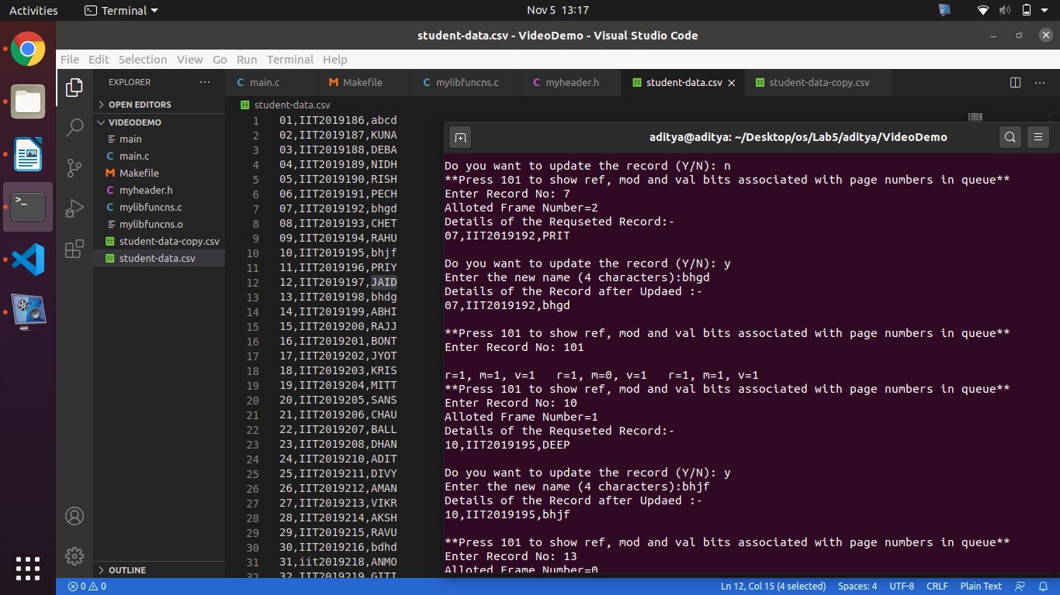

Slide 21
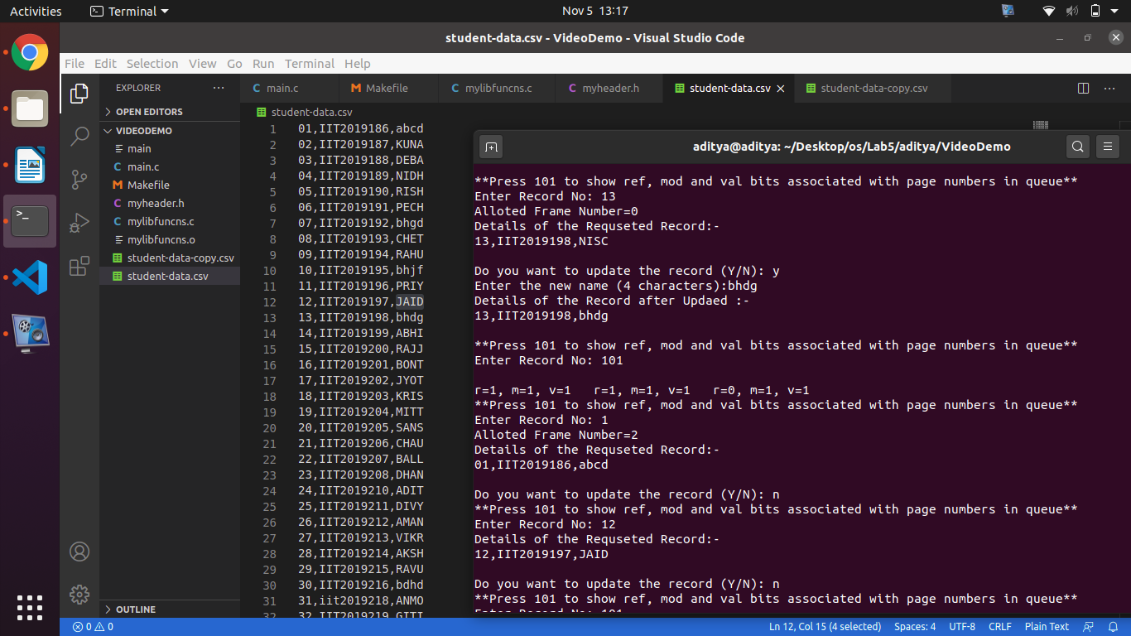

Slide 22
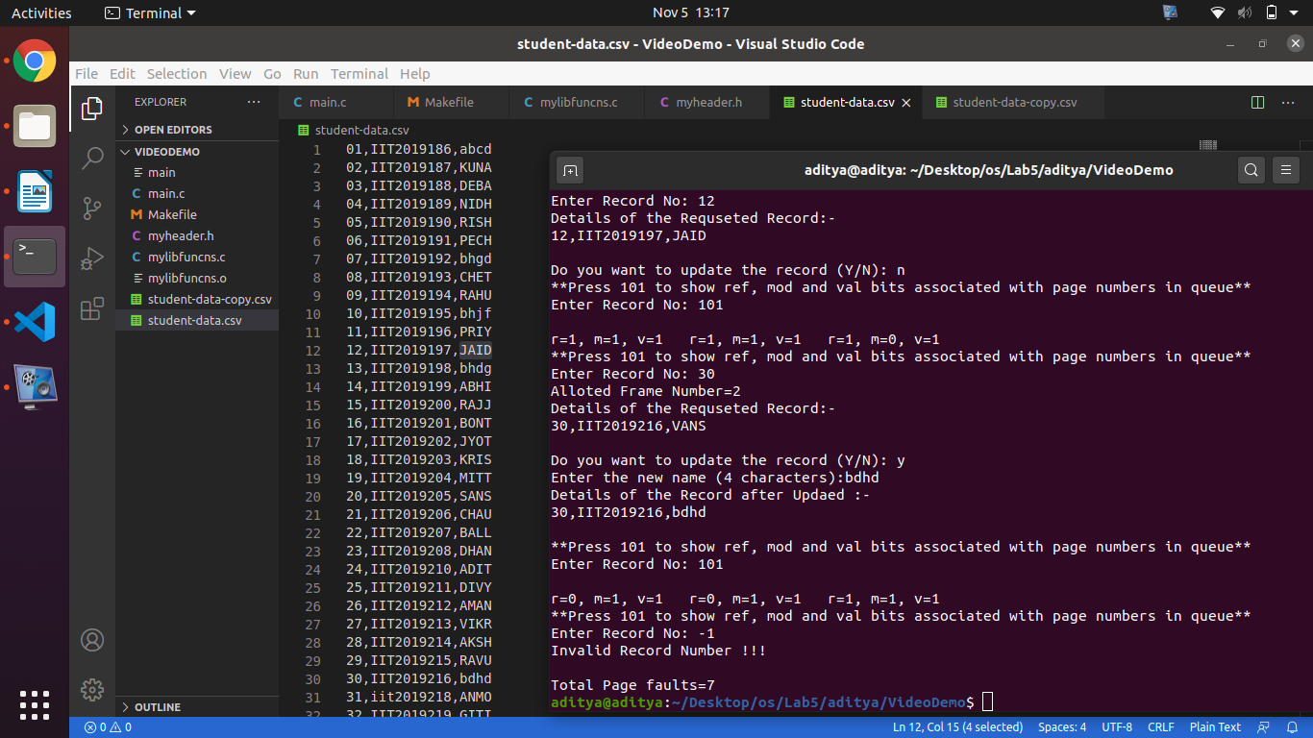

Slide 23
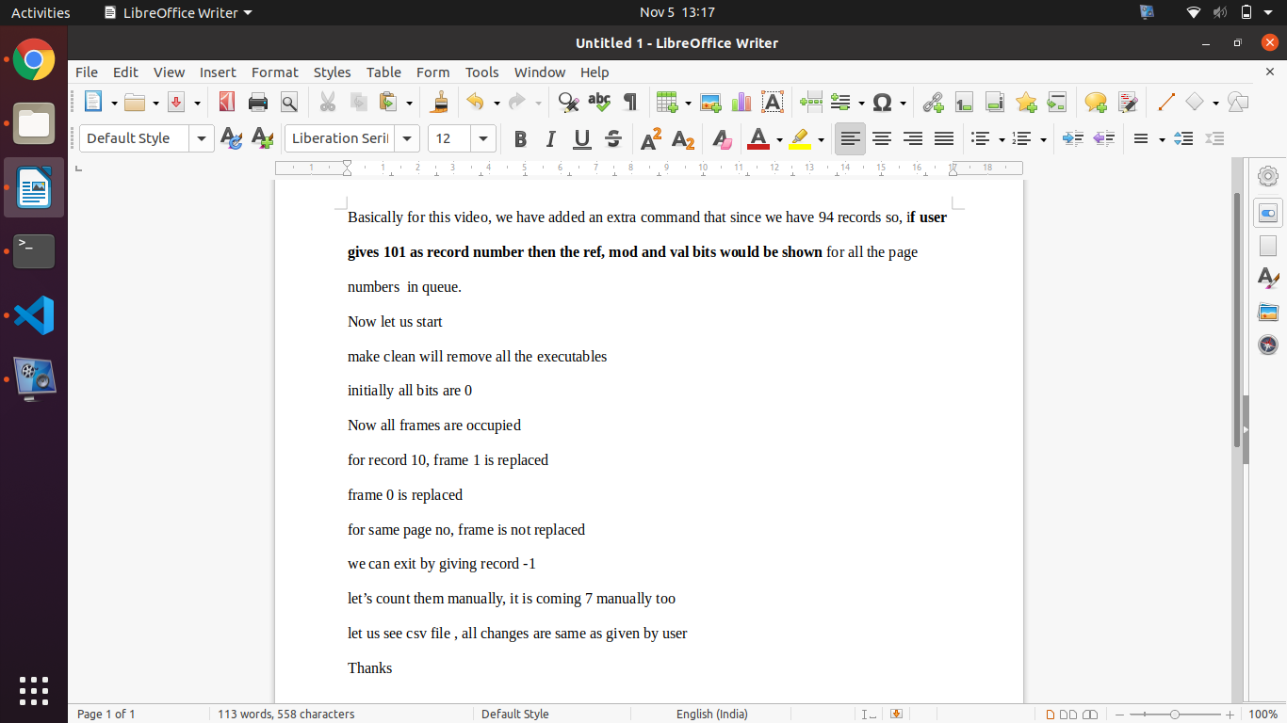

Slide 24
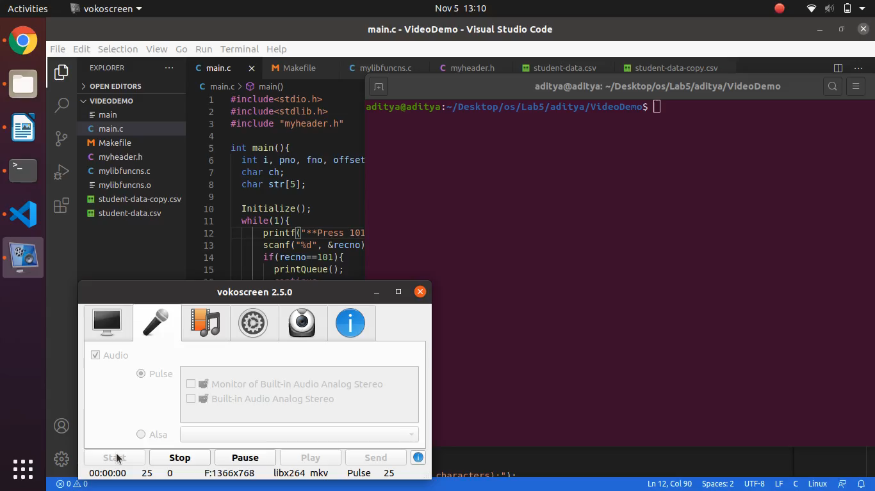

Slide 25
THANKS

